Slide 1

MARYLAND DEPARTMENT OF HEALTH
Developmental Disabilities Administration
Baltimore County Provider Council
April 24, 2018
Notes:
Thank you for having me. Your third choice of presenter behind Mardi Adams and Dir. of Fed Programs, Rhonda Workman. Enthusiasm for supporting individuals and families challenged by disabilities.

Slide 2
Agenda
DDA Overview
Eligibility
DDA Medicaid Waiver Programs
  Service Models
  Waiver Services

Slide 3
Developmental Disabilities Administration
We believe that ALL people have the right to live, love, work, learn, play and pursue their life aspirations in the community
We partner with people with developmental disabilities and families to provide support and resources to live fulfilling lives
We provide a coordinated service delivery system to enable children and adults with intellectual and developmental disabilities and families to work toward self-determination, interdependence, productivity, integration, and inclusion in all facets of community life across their lifespans
We are one of many resources, services and supports available to assist individuals and families as they build their lives toward their vision of the of the “Good Life”
Notes:
No disability too severe for someone to participate fully and find fulfillment all realms of the community.
As an agency, our job is to not to care for or program for, but to partner with people with disabilities and their families.
Our coordinated delivery system has a purpose: that through it, people young and old with intellectual and devlpmental disabilities will determine their own life choices, be productive, interdependent with those they hold close and integrated and included in community life throughout their lifespans.
We are only part of the solution. For any individual and family, there are many resources and supports to help people build and achieve their vision of a good life.

Slide 4

DDA’s Supports
Children
Adults
Families

Slide 5
DDA’s Essential Focus Areas for Community Living
Self-Determination
Self-Advocacy
Employment
Supporting Families
Independent Housing
Notes:
Our services and supports are all designed around five unifying principles.

Slide 6

Eligibility vs. Entitlement
In Maryland, a student with a disability who is receiving special education services is entitled to a free appropriate public education through the school year in which the student turns 21 years of age (Individuals with Disabilities Education Act (IDEA), 2004) or has met the requirements for a Maryland High School Diploma or a Maryland High School Certificate of Program Completion
Once a student exits school he or she must meet the eligibility criteria and funding availability to attend post-secondary education and/or receive services from adult service agencies
The DDA services are provided based upon “eligibility” for services and the availability of funding
Notes:
Your Council focuses on aging, but I wanted to include this slide just to highlight how DDA’s services are different from public entitlement programs.

Slide 7
DDA Application Process
Application- Includes information about age, disability or disabilities, Medical Assistance, etc.
Supporting Documentation- Relevant professional assessments. Important to have the most recent psychological assessment with adaptive skills testing
Recommendation Process- collect more information as needed, interview, recommendation for eligibility and priority category
Review Process- Reviewed though the local regional office
Application available online
https://dda.health.maryland.gov/Pages/eligibility.aspx
Notes:
Though it can feel overwhelming and scary, DDA has a generally straightforward application and entry process. All online.

Slide 8

DDA Eligibility Categories
“Developmentally Disabled” (DD)
“Supports Only” (SO); or
Not Eligible
Notes:
Because there is always a finite amount of funding, we cannot support every person with a disability or even every person with a developmental disability. We use wait lists, eligibility categories and priority statuses to direct our limited funding where it’s needed most, and where it most closely aligns with the purpose of our administration as defined by Maryland law and regulation. We have some mysterious sounding eligibility categories.

Slide 9
“Developmentally Disabled”
Eligibility:
  Is attributable to a physical or mental impairment, other than the sole diagnosis of mental illness, or to a combination of mental and physical impairments
  Is manifested before the individual becomes 22 years old
  Is likely to continue indefinitely
  Results in an inability to live independently without external support or continuing or regular assistance
  Reflects the need for a combination and sequence of special, interdisciplinary, or generic care, treatment, or other services that are individually planned and coordinated for the individual
Notes:
5 criteria, and depending on how many are met, a person is determined to be DD eligible, eligible for supports only, or not eligible for resources and services through DDA.

Slide 10
“Developmentally Disabled”
Individuals with a developmental disability diagnosis are not necessarily eligible for services under the DDA
Eligibility is not based on category or name of disability
The need to meet all specific criteria established in law and therefore the importance of functional assessments
Notes:
Must meet all five criteria.

Slide 11
“Supports Only”
Severe chronic disability that is:
  Attributable to a physical or mental impairment other than a sole diagnosis of mental illness, or to a combination of mental and physical impairment
  Likely to continue indefinitely
Notes:
Someone may for example have a mild intellectual disability, which will likely never change. But say that same person works in an office, gets herself to and from work on a city bus, maintains her own apartment and pays rent every month. And does all of that with minimal assistance from her family and other natural supports – for example her church. Determined “supports only.” Misnomer….

Slide 12
Priority Category
  Crisis Resolution: The person is in crisis or emergency situation (for example - abuse, neglect, homeless)
Crisis Prevention: Person is or will be in a health or safety crisis within the next year
Current Request: Person needs/wants services through health and safety are not the immediate issues
Notes:
Wait list is one of the most difficult aspects of our waivers, for people with clear and sometimes severe disabilities. D/t need to ensure funds go first to those that need it most. All but 16 states use wait lists to manage resources. TX has the most:117,000. MD maintained 12,000 on the waitlist, but in the past 3 months have been bringing in hundreds, eventually 1100 due to our two new support waivers and our ability this year to bring everyone in from CR and some from CP.
Adult-only waivers, including Living at Home, Older Adults, and TBI.

Slide 13
Determinations and Notice
Persons is eligible for full “DD” services funding or Supports Only:
  Approval letter with priority status
  Placement on DDA Waiting List
  OR
Person is not eligible for either full “DD” service funding or for Supports Only:
  Denial letter with appeal rights

Slide 14
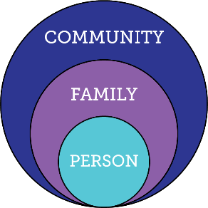
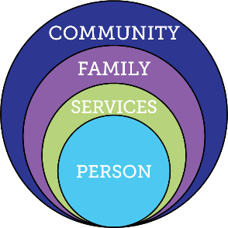
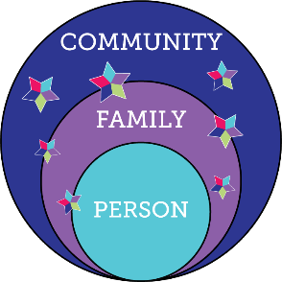

Integrated Services & Supports Across the Lifespan
Person - Family - Community
Traditional Disability Services
Integrated Services and Supports
within context of person,
family and community
LifeCourse Family Circles product of F2F LifeCourse Network/ UMK, UCEDD
Notes:
Through better regulations, polices and practices our goal is integrated supports & services. Serve the person where he/she is, how and when he/she needs services based on what’s important to and for him/her.

Slide 15

Integrated Star/Supports
Personal Strengths & Assets
Technology
Life experiences, personal knowledge, personality traits, religious affiliations social skills, education, and training
Relationships
Electronic reminders
Alarm clock
Tablet, Smart phone
Smart phone apps
Educational/life skills apps
Online job search support
Calculator
Computer
Family, Friends,
Spouse, Siblings,
Coworkers
Children, Grandparents,
Teachers, Mentors, Acquaintances
Business partner
“The Good Life”
Volunteering
Competitive employment/careers
Colleges, universities, tech school
Micro-enterprises
Self employment
Tutors
Parent/Teacher Association (PTA)
Summer Reading Program (library)
Developmental Disability Services
Special Education
Medicaid,
DORS,
Food Stamps,
Section 8 Housing
DDA
Community Based Supports
Eligibility Specific Supports
LifeCourse Integrated Star product of F2F LifeCourse Network/ UMK, UCEDD
Notes:
Describe the various aspects/resources of the Star. 4 pts Not just for people with intellectual and developmental disabilities. Everyone. Eligibility specific supports can be helpful and needed, but they are less associated with the things people identify as giving them a Good Life.

Slide 16
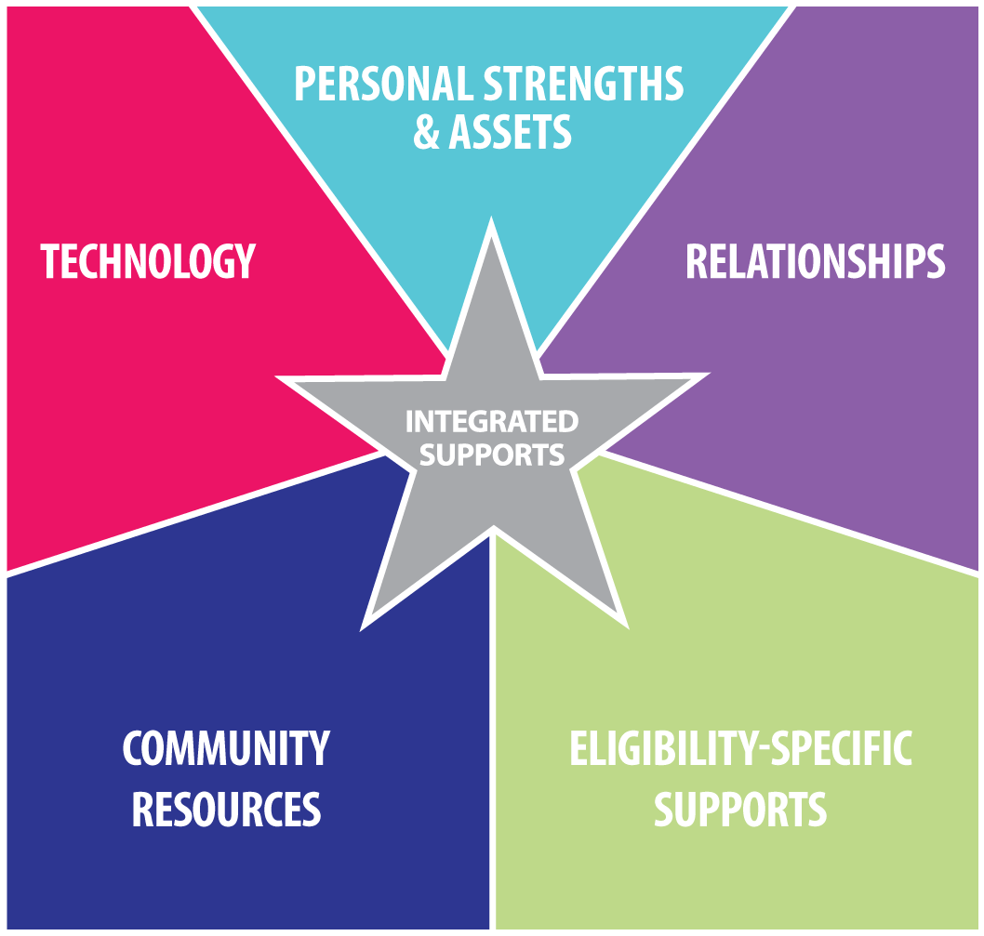

Not such a “Good Life”
Integrated Supports
Good Life
Eligibility
Supports Only
Isolated, loneliness, segregated, restricted, lack of choice, boredom
LifeCourse Integrated Star product of F2F LifeCourse Network/ UMK, UCEDD
Notes:
Describe, how eligibility specific services alone aren’t enough / don’t lead to the good life

Slide 17


DDA Waivers
Family
Supports
Waiver
Children birth to 21 years
Community
Supports
Waiver
Community Pathways
Waiver
Various Support Services
Children and adults
Service Cap of $12,000 annually
Meaningful Day and Support Services
Service Cap of $25,000 annually
Children and adults
Meaningful Day, Support, and Residential Services
Notes:
All DDA Waivers will have option of self-direction or traditional services delivery models

Slide 18
DDA Service Delivery Models
Self-Directed Model
Traditional Model
Promotes personal choice and control over the delivery of services and budget
Participant or designated representative assumes employer and budget authority responsibilities as the “employer of record”
Employer Authority responsibilities include:
  decision-making authority to recruit, hire, train and supervise the individuals who furnish their services
Budget Authority responsibilities include:
  decision-making authority over how the Medicaid funds in a budget are spent
Services provided by various DDA Approved or Licensed community agencies
Provider assumes all responsibilities as the “employer of record”
Slide #18
Notes:
DDA Services rely on Medicaid dollars for funding.
DDA offers two service models: Traditional and Self-Direction.
Both models are funded using Medicaid dollars
Whether an individual chooses “traditional” or “self-direction” has no impact on the source of funding.
Individuals opting for self-direction choose to be the employer of record.
Reference:
CMS defines Self-Directed Services
Self-directed Medicaid services means that participants, or their representatives if applicable, have decision-making authority over certain services and take direct responsibility to manage their services with the assistance of a system of available supports. The self-directed service delivery model is an alternative to traditionally delivered and managed services, such as an agency delivery model. Self-direction of services allows participants to have the responsibility for managing all aspects of service delivery in a person-centered planning process.
Self-direction promotes personal choice and control over the delivery of waiver services, including who provides the services and how services are provided. For example, participants are afforded the decision-making authority to recruit, hire, train and supervise the individuals who furnish their services. CMS calls this "employer authority." Participants may also have decision-making authority over how the Medicaid funds in a budget are spent. CMS refers to this as "budget authority.“
https://www.medicaid.gov/medicaid/ltss/self-directed/index.html

Slide 19

DDA Service Categories
Meaningful Day Services
Support Services
Residential Services
Slide #19

Slide 20
DDA Waivers - Meaningful Day Services
Meaningful Day Services | FSW | CSW | CP
Supported Employment (Transitioning to the new Employment Services in 2019) |  | X | X
Employment Discovery and Customization Services (Transitioning to the new Employment Services in 2019) |  | X | X
Career Exploration (Previously titled Transitional Employment Services) |  | X | X
Facility Based Supports |  | X | X
Small Group Supports |  | X | X
Large Group Supports |  | X | X
Community Development Services |  | X | X
Day Habilitation |  | X | X
Medical Day Care |  | X | X
Note: FSW-Family Supports Waiver, CSW-Community Supports Waiver, CP-Community Pathways Waiver

Slide 21

DDA Waivers - Meaningful Day Services
Meaningful Day Services | FSW | CSW | CP
Employment Services |  | Phase in July 2019 | Phase in July 2019
Discovery
Job Development
Follow Along
On-going Job Supports
Co-Worker Employment Supports
Customized Self-Employment

Slide 22
DDA Waivers - Support Services
Support Services | FSW | CSW | CP
Assisted Technology and Services | X | X | X
Behavioral Support Services | X | X | X
Behavioral Assessment | X | X | X
Behavioral Plan | X | X | X
Behavioral Consultation | X | X | X
Brief Support Implementation Services | X | X | X
Environmental Assessment | X | X | X
Environmental Modifications | X | X | X
Family and Peer Mentoring Supports | X | X | X*
Family Caregiver Training and Empowerment Services | X | X | X*
Individual and Family Directed Goods and Services (Self-Direction Only) | X | X | X*
Goods and Services (up to $5000) | X | X | X*
Staff Recruitment and Advertisement (up to $500) | X | X | X*
Housing Support Services | X | X | X*
Support Services | FSW | CSW | CP
Live-In Caregiver Supports |  |  | X
Nursing Consultation |  | X | X*
Nursing Case Management and Delegation Services |  | X | X*
Nursing Health Case Management |  | X | X*
Participant Education, Training and Advocacy Supports | X | X | X*
Personal Supports | X | X | X
Remote Support Services |  |  | X*
Respite Care Services | X | X | X
Daily Rate | X | X | X
Hourly Rate (up to 8 hrs) | X | X | X
Camp | X | X | X
Support Broker Services | X | X | X
Transition Services |  |  | X
Transportation | X | X | X
Vehicle Modifications | X | X | X
Note: * New service proposal for 7/1/18 implementation

Slide 23
DDA Waivers - Residential Services
Residential Services | FSW | CSW | CP
Community Living--Enhanced Supports |  |  | Phase in July 2019
Service
Trial Experience
Retainer Fee
Community Living --Group Home |  |  | X
Service |  |  | X
Trial Experience |  |  | X
Retainer Fee |  |  | X
Shared Living |  |  | X
Matching Service |  |  | X
Host Home Stipend |  |  | X
Supported Living |  |  | Phase in July 2019

Slide 24
DDA’s Regional Offices
Region Office | Counties Served | Phone
Lisa Ott, Director Central | Anne Arundel County, Baltimore City, Baltimore County, Harford County, Howard County | 410-234-8200 TDD: 410-363-9430
Kimberly Gscheidle, Director Eastern | Caroline, Cecil, Dorchester, Kent, Queen Anne's, Somerset, Talbot, Wicomico, and Worcester Counties | 410-572-5920 TDD: 1-800-735-2258
Judy Pattik, Director Southern | Calvert, Charles, Montgomery, Prince George's, and St. Mary's Counties | 301-362-5100 TDD: 1-888-207-2479
Cathy Marshall, Director Western | Allegany County, Carroll County, Frederick County, Garrett County, Washington County | 301-791-4670 TDD: 1-888-791-0193

Slide 25

Questions

