Slide 1
“Dealing with grief when your job is taking care of others”
Hilary Harrington, LCPC, CT
Clinical Grief Counselor, Gilchrist
October 23, 2018

Slide 2




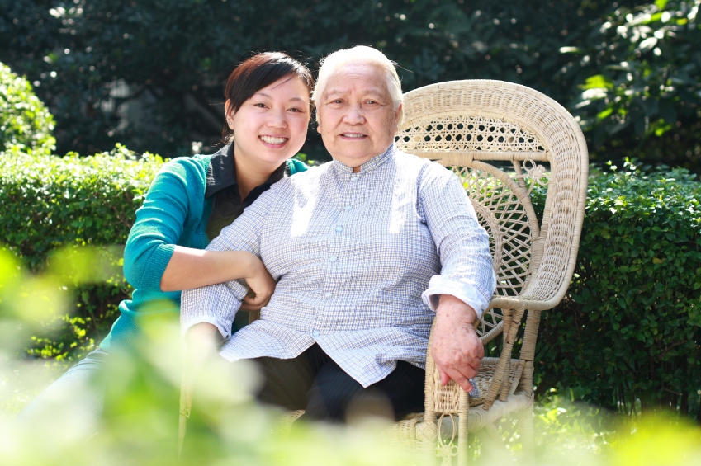

Professional Caregivers are …
This Photo by Unknown Author is licensed under CC BY
Notes:
“Let’s take a minute to identify professional caregivers”;
Ask group to describe professional caregivers
why they wanted to be a caregiver
Where else are you caregivers?

Slide 3

The Challenges of Caregiving …
It can be
  Confining
  Confusing
  Disappointing
  Demanding
  Exhausting
  Isolating
  Stressful
Notes:
Ask are there any other challenges?

Slide 4

The Concerns of a Caregiver…
Inability to “do it all”
Exhaustion
Frustration
Feeling guilty
Feeling angry or resentful
Fear of death
4.1%
Notes:
Worries caregivers have/develop
Others?

Slide 5

Today …
Understand how:
grief and loss impact caregivers
stress and burnout are related to grief and loss
self care supports your performance
Notes:
In our time together, hopefully we can explore…

Slide 6

Our Death-Denying Culture
Desire to avoid:
thinking about death
talking about death
being around people who are dying
being around people who are grieving
Notes:
Death: hushed topic in America; refrain from using the word “dead”, try to make it sound more appealing (Passed away),
we do the polite expected things when we express condolences
and we turn to funeral directors to take care of the business
we want to move on quickly and back to life as normal
likely this has increased a lack of acceptance and peace with death

Slide 7

The Unavoidable Reality….
  People die
  People we care for die
  Grief is a necessary process
  People we care for are grieving
Notes:
Death is a part of life cycle – we don’t need to avoid it,
avoiding it and the resulting grief only increases ones distress,
sometimes we can embrace death or grief in our personal lives,
but in our professional lives it may seem different

Slide 8
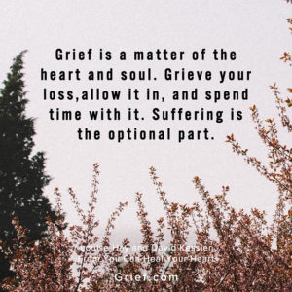
Understanding Grief
Notes:
What do you know about grief?
How would you define it?
How have/Or have you experienced it?
It can be helpful to take an inventory of:
1) your loss history, 2) what you know about grief and 3) how you have dealt with it

Slide 9
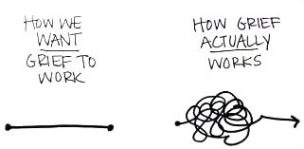
Processing Grief not Stages of Grief
Elizabeth Kubler-Ross “5 stages”
William Worden “4 Tasks of Grief”
No straight path
No time line
Unpredictable with common experiences
You don’t “Get over it”
Unique to each griever
Notes:
More current thanantologists speak to “process” or “tasks”
1969 E.K.R. Stages (denial/anger/bargaining/depression/acceptance) vs Worden Tasks (Accept reality/process pain/adjust/find enduring connection

Slide 10
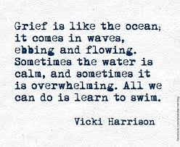
Notes:
But we are always healing even if we don’t know it, we keep moving forward each day even with the ups and downs

Slide 11
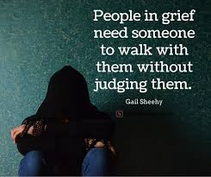
Notes:
Expected to “move on” “be normal”,
work – 3 day leave,
expected losses = shorter grief or no grief,
losses at work may go unaddressed or don’t make room for grief – accumulate

Slide 12

“Thinking and talking about death
need not be morbid;
they may be quite the opposite.
Ignorance and fear of death overshadow life, while knowing and accepting death
erases this shadow.”
Lily Pincus
Notes:
Lily Pincus – author topics of death and the family
Its not “Morbid” or “wrong” – pushing it away doesn’t make it “go away”

Slide 13
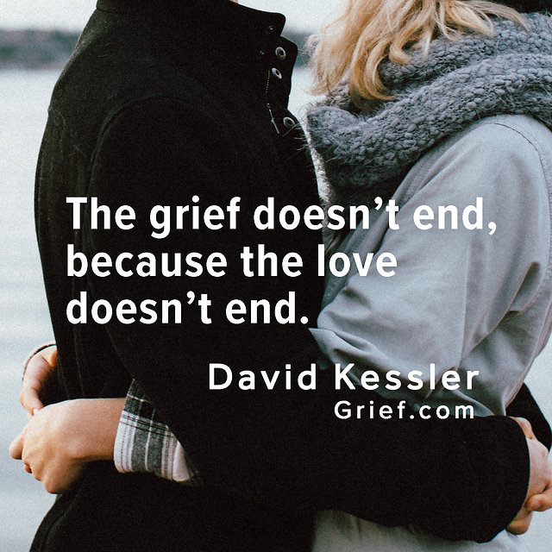
Notes:
So in this way grief continues – but the pain can leave you,
missing and loving go on = bittersweet moments

Slide 14

Grief and The Professional Caregiver …
Death can be “part of the job”
We care with compassion
We must continue to work
Don’t want to appear weak
Cumulative sadness and multiple losses takes it toll
Losses not related to death?
Notes:
Loss of :
ideal/dream career we entered
role/identity that came with job
energy
friends, fun, sense of community
self-esteem/self worth
joy, purpose that makes it worthwhile

Slide 15
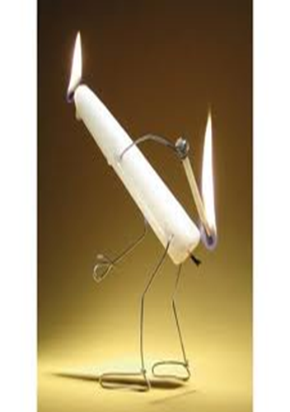
Stress… Burnout …
Over-engaged
Over-reactive
Sense of urgency and hyperactivity
Loss of energy
Can feel anxious
Physical impact
Disengaged
Blunted emotions
Feel helpless and hopeless
Loss of motivation ideals hope
Detached, depressed
Emotional impact
Notes:
Stress – end in sight even if it’s difficult to get there
Burnout – cycle of negativity without allowing room for restorative measures

Slide 16

What’s your grief?
Loss history
Grief experience
Coping skills
Comfort with death
Self Care
This Photo by Unknown Author is licensed under CC BY-SA-NC
Notes:
Let’s begin talking about what to do when grief/loss shows up in the workplace
Hx/Experience- taking an inventory is good way to know where to start/what you need help with/warning signs

Slide 17

Prevention
Develop ways to manage stress
Eat healthy, exercise, get good sleep
Maintain professional boundaries
Take a break from technology
Be creative – choose activities that have nothing to do with work
Talk about it
Notes:
What can you do now? Start with a relaxing ritual – spend 15 minutes doing it
3 things that help work through trauma (sleep/creative/mindfulness);
BOUNDARIES = avoid burnout;

Slide 18

Recovery
#1 Slow Down – give yourself time to rest, reflect, heal
#2 Get Support – avoid isolating, seek out friends and family, share what is going on can bring about some relief
#3 Reevaluate Goals and Priorities

Slide 19
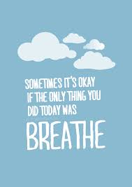
Notes:
When you are grieving feeling “traumatized” or unstable, they grounding activities help because they are nurturing and affirming.

Slide 20
MINDFULNESS
Is a simple and powerful practice
Is training your attention
Is paying attention to the here and now
Is practice in non-judgement
Is a way to prevent getting lost in thoughts (about future or past)
Is a way to reduce stress
Full Catastrophe Living by Jon Kabat-Zinn

Slide 21



Honoring and Remembering

Slide 22
