Slide 1
Diversity, Equity, and Inclusion in Senior Living
Dr. Jeffrey R. Ash
University of Maryland, Baltimore
School of Nursing
Associate Dean, Diversity and
Inclusion, Assistant Professor
September 27, 2022

Slide 2
Discussion Objectives
Environmental Setting
To better understand key definitions and terms
Diversity Equity Inclusion-Belonging
Bias Race Anti-Racist Stereotypes
To help everyone be better AWARE
Contextualize Identity
To offer recommendations and solutions going forward

Slide 3
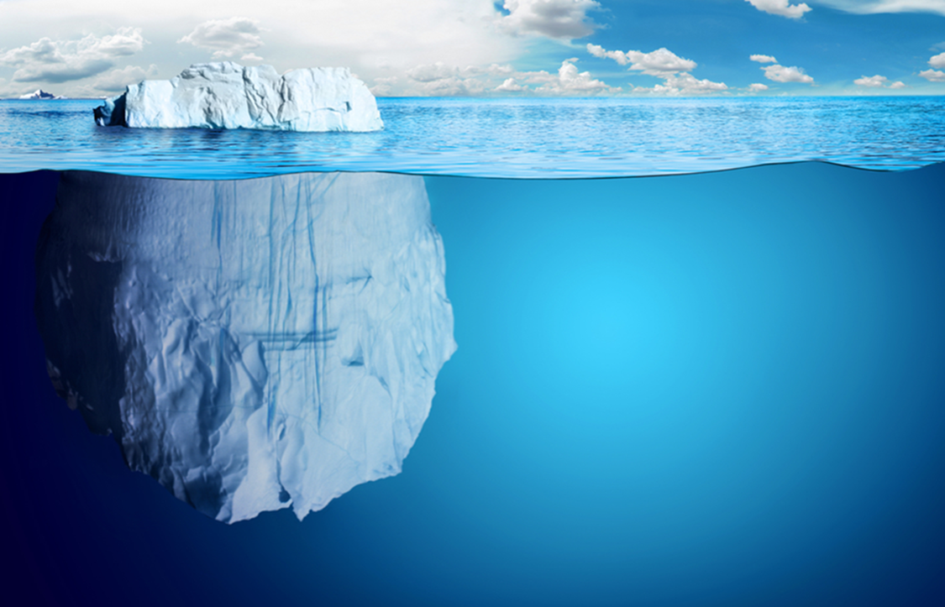
Diversity, Equity, Inclusion, and YOU
Notes:
Sullivan report-why my job exists

Slide 4
What is Diversity
What is Diversity?
What Diversity is NOT?
Contextualizing Identity

Slide 5
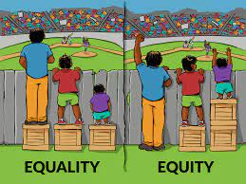
EQUITY
Notes:
Sullivan report-why my job exists

Slide 6
Barriers to Inclusion
S.C.A. R.F.
CULTURE /CLIMATE
SPEED
HISTORY / MYTHS
SENIOR LIVING DYNAMICS
Notes:
USM Diversity Language- With the words-there has to be action that is consistent with the behavior..Although the words matter is the ACTIONS, BEHAVIORS, and THIS FEELING

Slide 7
Assisted Living-Living “Here”
“ I have been living here for quite a while. Everything is very clean, people are friendly, and I have enough to eat, but this is no way to live”
What is this statement Saying?

Slide 8
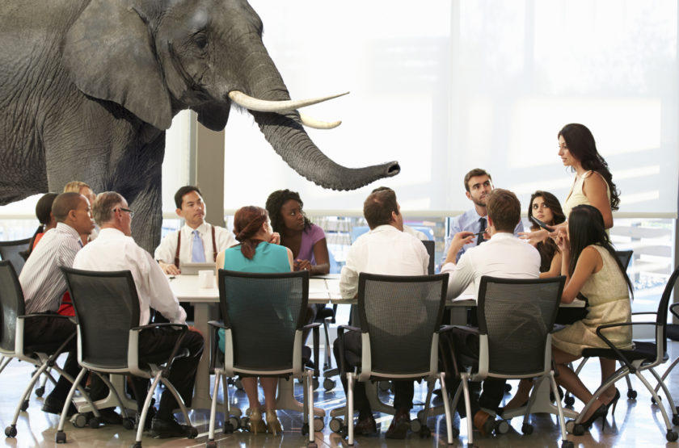
From Moving In- Living here

Slide 9
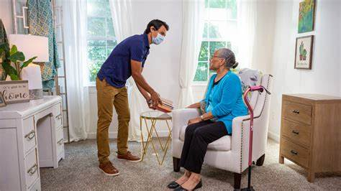
Let’s- Talk About the Barriers

Slide 10
Lets Talk About It
Speed
Vaccine hesitancy
Counting on Kindness
Affordability
Culture-What is undiscussable and WHY
The “Only” One
Gaps / Myths
Family-Providers-Patients-Residents
Diversity and lack of representation
C-Suite
Boards
Status-Uncertainty-Fear-Anxiety
Notes:
USM Diversity Language- With the words-there has to be action that is consistent with the behavior..Although the words matter is the ACTIONS, BEHAVIORS, and THIS FEELING

Slide 11
Let’s talk about it
Dynamics
  Working Here, But can not afford to live here
  Language and Accents
  Representation at all levels
    Not about counting people, make people count
    Inclusion and support
  Westernizing, “American-izing” my name
  Staff work for me, because I pay for you
    Expectations

Slide 12
Caring for each other
Silence Speaks (No more) Statements (need action)
Town Halls, and Smaller group settings
Check In
Partner, form consortiums, collaborate
Humility-Go from Good to Great
Affinity Groups

Slide 13
Concluding Thoughts/ Recommendations
Not enough to care, Care + saying and doing
Neutral-no longer acceptable- Be a True Ally
  Opposite Assimilation-Survival
Everything Speaks
Unpack YOU
  Your communication, your bias, your EQ
Be Super Observant
Hire a Diversity officer
A rising tide raises all boats
Educate Yourself (continually)
  Read, spend time with, conversations, be authentic-go 1st

Slide 14
Going forward
Innovate-
Do not allow ignorance to be “Weaponized”
“ Center DEI”
Data
  What story does data convey about your organization
  Leverage Data
Metrics and Measured
  What gets measured gets done
  What gets resourced gets done, and what gets done is resourced

Slide 15
Resources
Cycle of Socialization (Harro, B)
Managing with the Brain in Mind (Rock)
Ladder of Inference (Senge)
How to Be An Anti-Racist (Kendi)
Flexner Report, Sullivan Commission
Partner-Collaborate
  Drjrob.ash@gmail.com , Jash@umaryland.edu
Implicit Association Assessments
Your organization chart
  Everyone contribute to diversity goals and plans

Slide 16
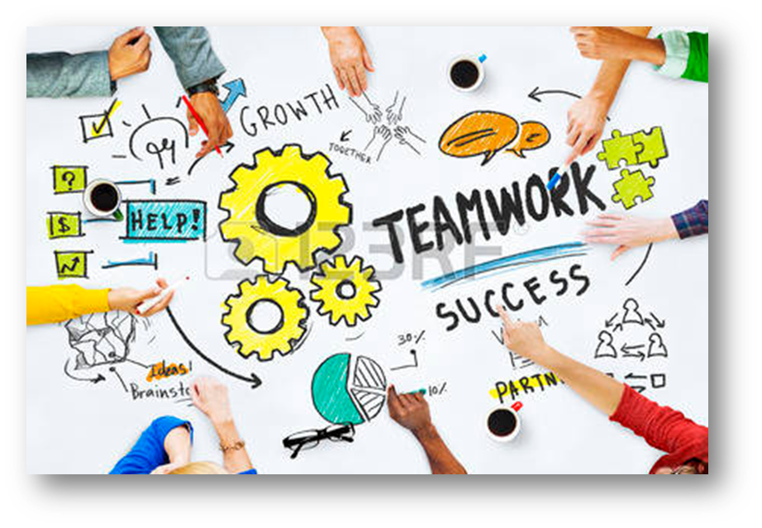
Questions
THANK YOU

