Slide 1
HealthCare Access Maryland
Central Region Connector
Aileen Zimmerman
Certified Navigator – Baltimore County

Slide 2
About HCAM
Non-profit agency created in 1997
Formerly Baltimore HealthCare Access
  Renamed to reflect expanded reach & focus
Originally two core programs:
  Eligibility
  Care Coordination
Today: 19 programs/30 grants
Areas of expertise:
  Eligibility & enrollment
  Navigation of health care system
  Care Coordination
  Education & Advocacy
Diverse and culturally competent staff
Notes:
Established in 1997 to assist with Medicaid transition to managed care.
HCAM recognized the changing landscape of health care; Agency shifted it’s strategic direction beyond Baltimore City to become a leader in bolstering health care throughout the state
Originally two core functions
Eligibility
Ombudsman Services/Care Coordination

Slide 3
Affordable Care Act
Patient Protection and Affordable Care Act
  Signed into law March 23, 2010
Health Care Reform
  ACA expands coverage to 800,000 uninsured in Maryland
Individuals, families, and small businesses are all eligible for coverage through ACA

Slide 4
Key Features
Coverage
Cost
Care
10 Essential Health Benefits

Slide 5
How will ACA effect my coverage?
Choice of doctor
  You can choose any doctor you prefer
  If a woman wants her OB/GYN to be her primary care physician, that is allowed
Children up to age 26 stay on their parents insurance
  52,000 in Maryland
Children with preexisting conditions are no longer denied coverage
  Insurers can no longer deny or limit coverage to children under age 19

Slide 6
What about the cost of insurance?
No more life-time dollar limits on care
More dollars are now spent on your care – not on administrative costs

Slide 7
What about the care being offered?
You can see the doctor of your choice
Preventive care
No pre-authorization required to go to the emergency room

Slide 8
10 Essential Health Benefits
Qualified Health Plans
  Ambulatory Services
  Emergency Services
  Preventive Care
  Maternal and Newborn Care
  Hospitalization
  Prescription Drugs
  Pediatric Services including dental and vision
  Habilitative and Rehabilitative Services
  Laboratory Services
  Mental Health and Substance Use Benefits

Slide 9
Expand Coverage
Medicaid expansion up to 138% FPL
Advanced Premium Tax Credits
  Reduces monthly premium
  138-400% FPL
Cost Sharing Reductions
  Reduces out-of-pocket costs
  100-250% FPL
Notes:
APTC: Individual: Couple:
CSR: Individual: Couple:

Slide 10
Individual Mandate
Individuals must obtain health coverage or pay a penalty
  2014: $95 or 1% of income
  2015: $325 or 2% of income
  2016: $695 or 2.5% of income
Exceptions:
  Financial hardship, religious objections, incarcerated individuals, undocumented immigrants, those for whom the lowest cost plan is 8 percent of annual income, and those whose income is below the tax filing threshold
Notes:
Individuals who cannot afford coverage
This applies if coverage costs more than 8 percent of a family’s income—and the cost of a family plan is taken into account, unlike in the test for subsidized marketplace coverage
Taxpayers with income below the filing threshold
The filing threshold is roughly $10,000 for individuals and $20,000 for married couples.
Members of Federally recognized Indian tribes
Religious conscience exemption for members of a recognized religious sects
Such sects must have been in existence since 1950
Members of a health care sharing ministry
Incarcerated individuals
Individuals who are not lawfully present
Individuals who experience short gaps in coverage (usually three months or less)
Individuals who qualify for a hardship exemption

Slide 11

Maryland Health Connection
The Health Exchange for the state of Maryland authorized in supplying individuals with health insurance approved by the Affordable Care Act
States had a choice to establish a state-based exchange, or join the federally-facilitated exchange; Maryland opted to establish a state-based health insurance exchange – Maryland Heath Connection

Slide 12
Maryland Health Connection
Individuals and small businesses can explore, compare, and enroll in private health plans or public assistance plans
Obtain access to tax credits and cost sharing reductions
The state-based health insurance exchange is NOT an insurer or issuer of health insurance plans

Slide 13
Maryland Health Connection
Maryland Health Connection offers tax subsidies and cost sharing reductions to individuals and families who do not have access to affordable health care insurance
  Federal government will pay a portion of costs for health insurance for people who earn up to 400% of FPL
  Cost sharing reductions are available to individuals under 250% of FPL
Open Enrollment Period: Oct. 1, 2013 – March 31, 2014
Coverage Effective: Jan. 2014

Slide 14


Maryland Health Connection
Eligibility determination
Plan Selection using standardized format to compare:
  Premium and co-pays
  Plan performance on quality measures
  Plan ratings by quality and price
Compare Apples to Apples
Need more assistance? Get help!
  Website
  Telephone
  Navigators

Slide 15
What Insurance is offered through the Maryland Health Connection?
Medicaid Expansion
  7 Managed Care Organizations
Private Insurance
  4 “metal levels” – bronze, silver, gold, and platinum
  10 Essential Health Benefits

Slide 16
Medicaid Expansion: up to 138% FPL
Approximately 100,000 new enrollees in 2014
Benefit package is the same
Simplified enrollment process
“No Wrong Door” policy

Slide 17
Medicaid Coverage
Coverage begins January 1, 2014
Retroactive Coverage
  For the month enrolled
Income level:
  Individual: $15,856
  Household of 2: $21,404

Slide 18
Life Changing Events
Life changing events include:
  Gain/loss of job, marriage, divorce, birth, death, increase/decrease in salary, relocate
If one of these occurs during the year, you must call the Maryland Health Connection and update your status.
  They will automatically re-determine your eligibility for “affordable” insurance

Slide 19
Connector Entity
Maryland is organized into 6 regions
One “connector entity” serves each region
Connector entities partner with local organizations to meet the needs of the entire region

Slide 20
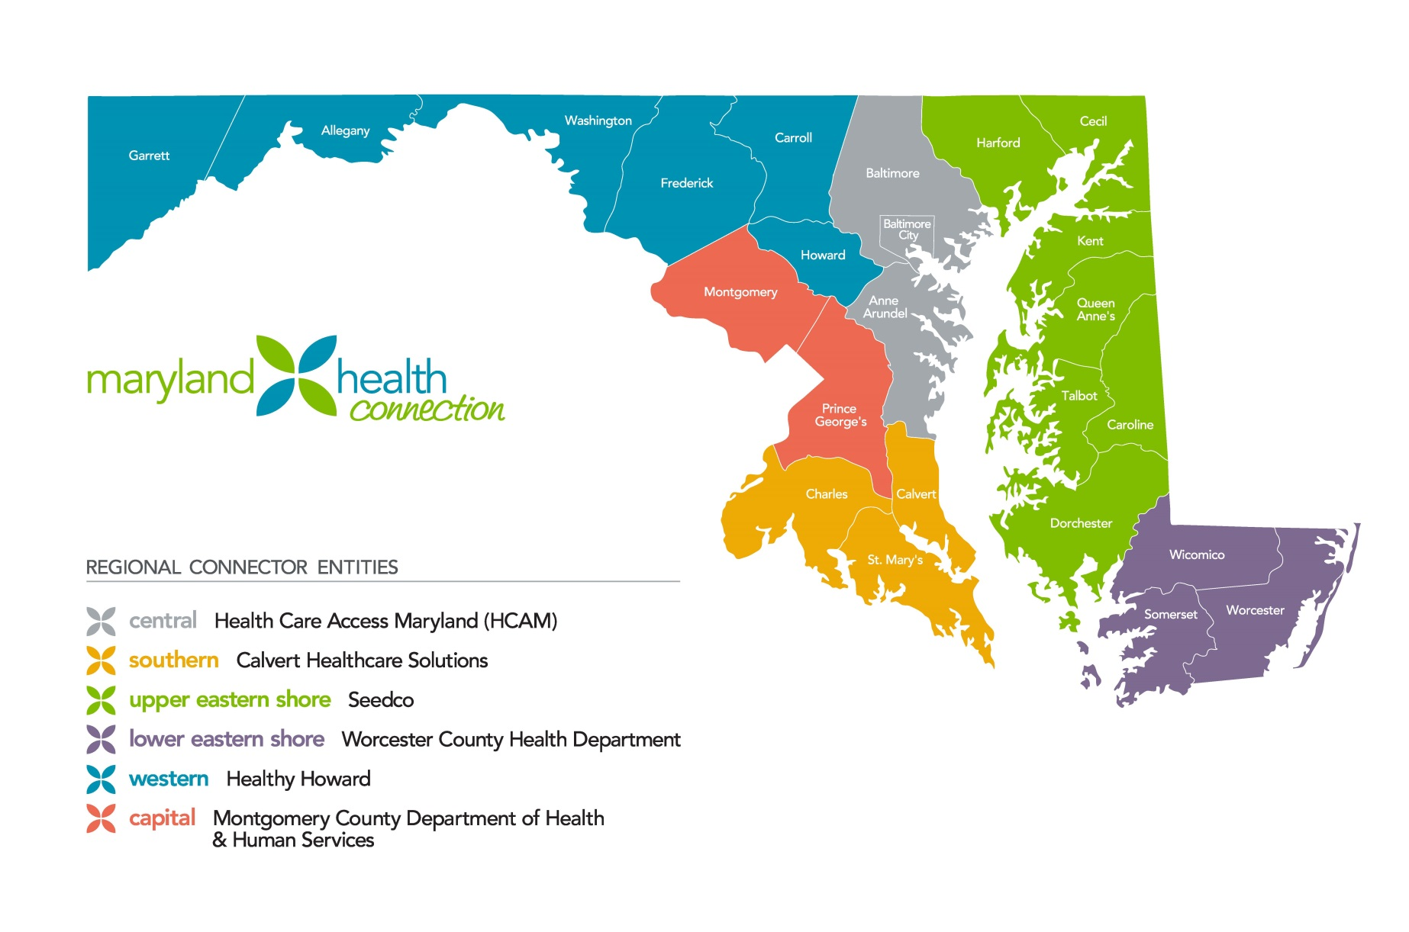
6 Regional
Connector Entities
Notes:
ACA will not be deemed a success if we don’t locate and enroll all those who are eligible
Advisory Committees in both 2011 and 2012 met to determine how the program would be designed and the requirements to create “certified navigators,” assisters, and the role of producers or insurance brokers

Slide 21
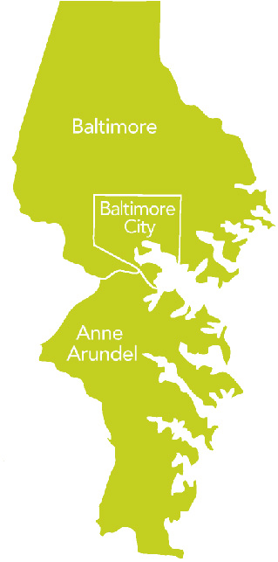
HCAM -- Central Region Connector
Central Region
Baltimore City
Baltimore County
Anne Arundel County
17 Partners/ Subcontractors
Local Health Departments
Department of Social Services

Slide 22
Central Region Partners/SubContractors
Anne Arundel Medical Center
Baltimore City Health Department
Baltimore Healthy Start, Inc.
Baltimore Medical Systems
Charm City Clinic
Chase Brexton Health Services
Chatman, LLC
Coordinating Center
Healthcare for the Homeless
Independent Marylanders Achieving Growth Through Empowerment Inc. (IMAGE)
Maryland Medical Society (MedChi)
Mental Health Association of Maryland (MHAMD)
Mercy Hospital
Mosaic Community Services
Park Heights Community Health Alliance
Planned Parenthood of Maryland
St. Stephens African Methodist Church/ Office Management &Technology (OMT/SSAME)

Slide 23
Uninsured in Baltimore County
80,000 Baltimore County Residents are Uninsured

Slide 24
Central Region Connector
HCAM and our 17 partners will employ 107 certified Navigators & trained Assisters to:
  provide outreach and education
  eligibility determinations
  facilitate enrollment of the 217,000 uninsured central region residents into Medicaid, MCHP & subsidized/unsubsidized qualified health plans
  80,000 in Baltimore County

Slide 25
Central Region Connector
Outreach/Education/Enrollment
Health Departments/Social Services
Faith-based organizations
Community based organizations: clinics, food banks, libraries, supermarkets
Civic Associations, clubs
Health fairs, festivals

Slide 26
Responsibilities
Navigators will:
  Conduct public education and outreach as required by the Affordable Care Act
  Distribute fair and impartial information
  Facilitate enrollment in health plans
  Provide referrals for grievances, complaints and questions
  Provide information in a culturally and linguistically appropriate manner
  Maintain expertise in eligibility, enrollment and program specifications
  Refer insured small groups and individuals back to producers
Assisters will:
  Conduct public education and outreach
  Facilitate enrollment in Medicaid
  Provide information in a culturally and linguistically appropriate manner
  Maintain expertise in eligibility, enrollment and program specifications
  Refer insured small groups and individuals back to producers
Both navigators and assisters will receive training through MHBE

Slide 27
Navigators in Baltimore County
Towson Department of Social Services – Lauren Lucas
(443) 925-9964
Reisterstown Department of Social Services – Kirsten Bickford
(443) 925-9137
Essex Department of Social Services – Roger Fenner
(443) 934-9452
Catonsville Department of Social Services – Tawanda Epps
(443) 934-9466
Dundalk Department of Social Services – Roshon Goode
(443) 934-9454
Liberty Workforce Development Center – Tanys Lee
(443) 934-9459
19 Baltimore County Public Libraries
Baltimore County Detention Center

Slide 28
Consumer Assistance
Online at www.MarylandHealthConnection.gov
  Shop
  Compare
  Enroll
In-person Assistance
  Navigators (Certified)
  Assisters (Non-Certified)
  Insurance Producers (Authorized)
  Captive Producers
  Application Counselors
Consolidated Services Call Center
  855-642-8572
  855-642-8573 – TTY
  Customer Service
  Application and enrollment assistance
  Language line/ translation services
  TTY for the hearing impaired
HCAM Call Center
  877-223-5201
Notes:
5 different categories of individuals providing consumer assistance
All will be trained on not only the eligibility criteria, benefit plans and other info required for consumers to make informed decisions but they will also require training on the IT systems – 40 hours for application process
Navigators – 150 state wide -- will work for an entity (ex. of MHAMD and HCAM)
Assisters – 250 state wide – will do outreach and help individuals through the first phases of eligibility
Producers/Brokers – work with individuals and primarily small businesses
Application Counselors – work w/ entities that currently do eligibility such as hospitals and LHDs
Captive Producers – work w/in an insurance carrier and sell only their products

Slide 29

Aileen Zimmerman
Certified Navigator – Baltimore County
443-858-4767
azimmerman@hcamaryland.org
www.healthcareaccessmaryland.org

